Slide 1
Chapter 7 Review
MATH 1550 - Precalculus

Slide 2

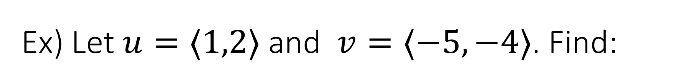
Ex) Let $u=⟨1,2⟩$ and $v=⟨−5,−4⟩$. Find:
$|u|$
$|v|$
$u+v$
$u−v$
$|u+v|$
$|u−v|$
If $w=⟨2,3⟩$, compute $3u−v+2w$.
$u⋅v$
The angle between $u$ and $v.$

Slide 3
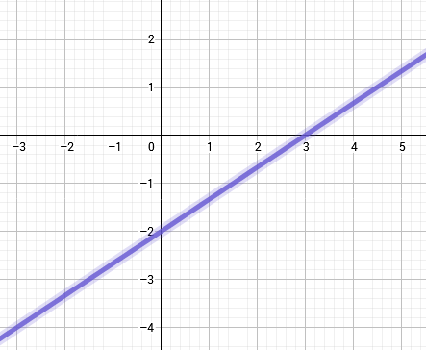
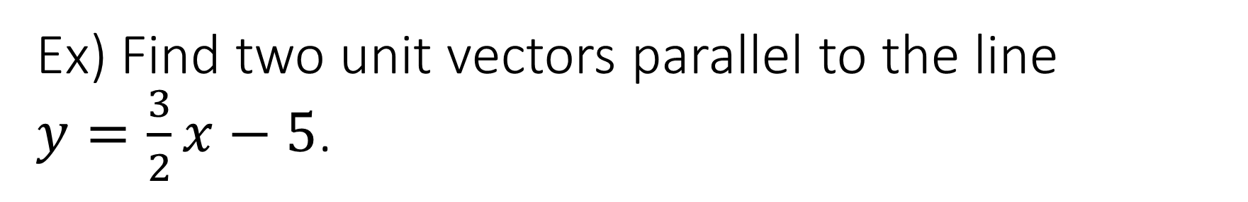

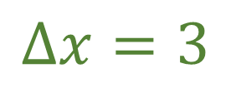
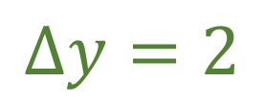
Ex) Find two unit vectors parallel to the line $y=\frac{3}{2}x−5$.
$$v$$
$$Δy=2$$
$$Δx=3$$

Slide 4

Ex) Determine if the following vectors are orthogonal:
$⟨−6,8⟩$ and $⟨−8,6⟩$
$⟨8,3⟩$ and $\left\langle −6,16\right\rangle$
$⟨6,−4⟩$ and $⟨−6,−9⟩$

Slide 5
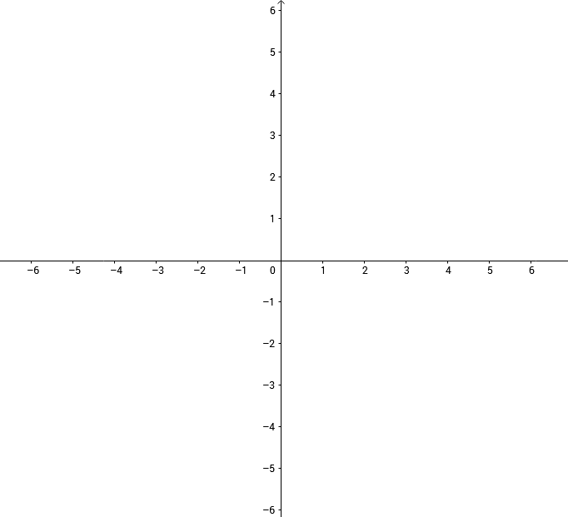












Negative Radius
$$\frac{2π}{3}$$
$$\frac{π}{3}$$
$$\frac{3π}{4}$$
$$\frac{π}{4}$$
Ex) Plot (-5, π/4)
$$\frac{5π}{6}$$
$$\frac{π}{6}$$
$$\frac{7π}{6}$$
$$\frac{11π}{6}$$
$$\frac{5π}{4}$$
$$\frac{7π}{4}$$
$$\frac{4π}{3}$$
$$\frac{5π}{3}$$

Slide 6

Ex) Convert the following points as directed:
$(−2,2)$ to polar
$(−5\sqrt{3},−5)$ to polar
$(2,\frac{π}{3})$ to rectangular
$(−3,\frac{7π}{4})$ to rectangular

Slide 7

Ex) Convert the following rectangular equations to polar:
$y=4$
$xy=16$
${\left(x^{2}+y^{2}\right)}^{2}=9(x^{2}−y^{2})$

Slide 8
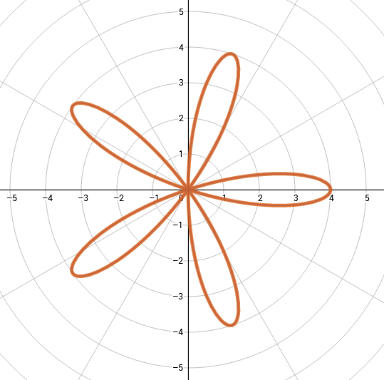

Ex) Find the range of θ that describes the petal of $y=4cos(5θ)$ on the x-axis.

